Slide 1



CARS ANALYSIS
View in Power BI
Last data refresh:
4/25/2025 6:28:02 PM UTC
Downloaded at:
4/25/2025 6:31:20 PM UTC

Slide 2
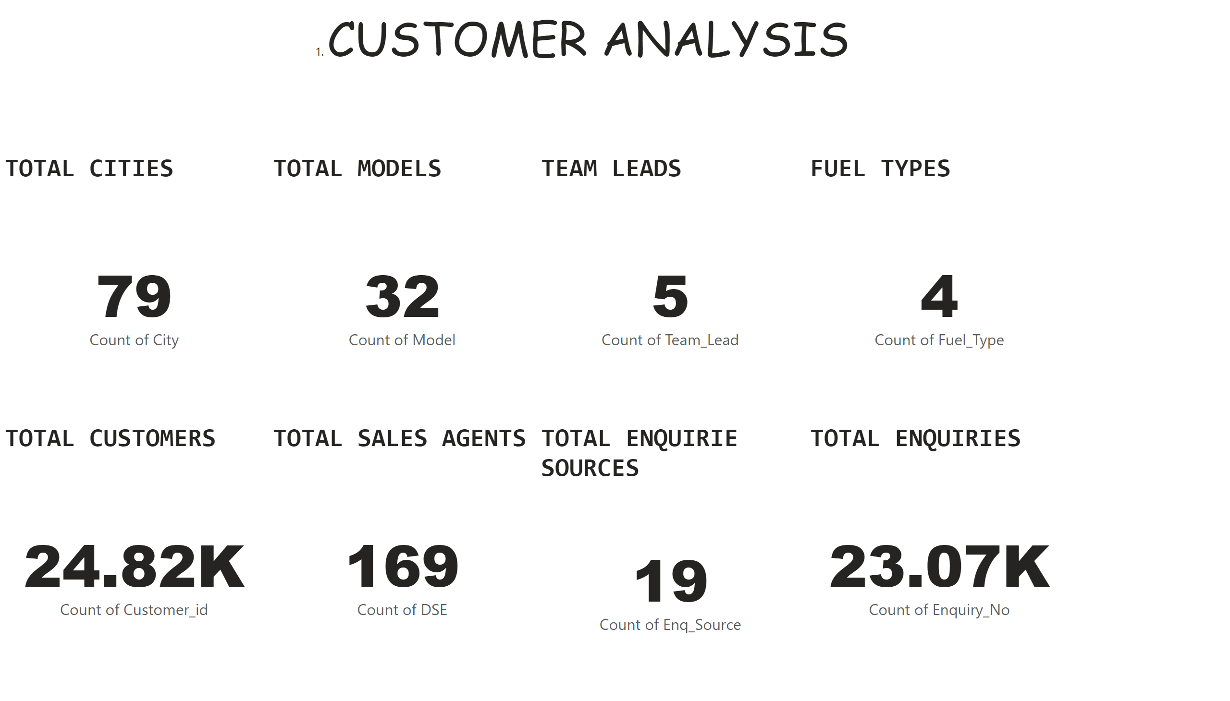
FRONT
Notes:
TOTAL CUSTOMERS
No alt text provided
TOTAL CITIES
No alt text provided
TOTAL SALES AGENTS
No alt text provided
TOTAL ENQUIRIE SOURCES
No alt text provided
TOTAL ENQUIRIES
No alt text provided
TOTAL MODELS
No alt text provided
TEAM LEADS
No alt text provided
FUEL TYPES
No alt text provided
textbox
No alt text provided

Slide 3
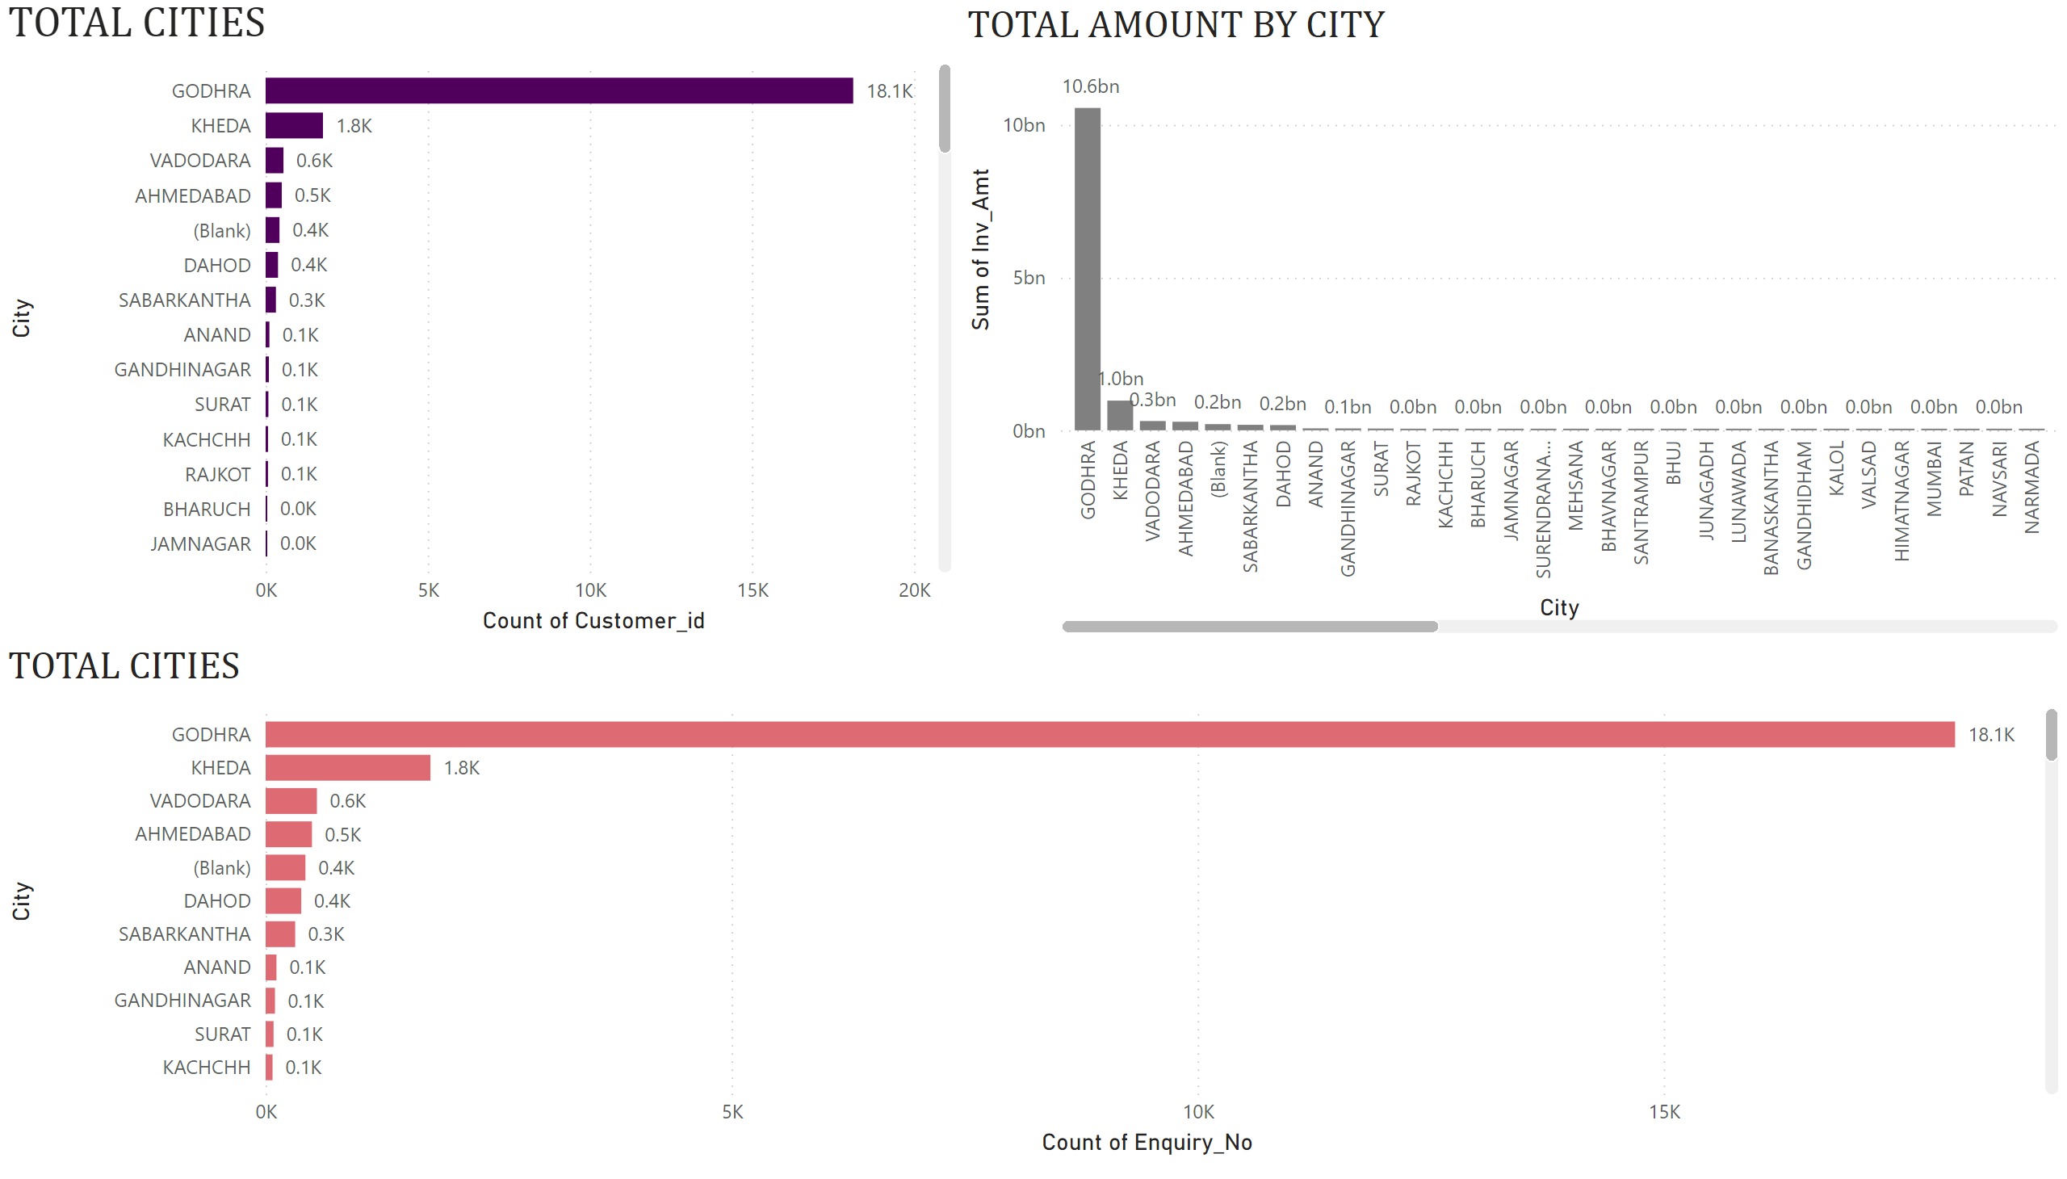
CITY
Notes:
TOTAL CITIES
No alt text provided
TOTAL AMOUNT BY CITY
No alt text provided
TOTAL CITIES
No alt text provided

Slide 4
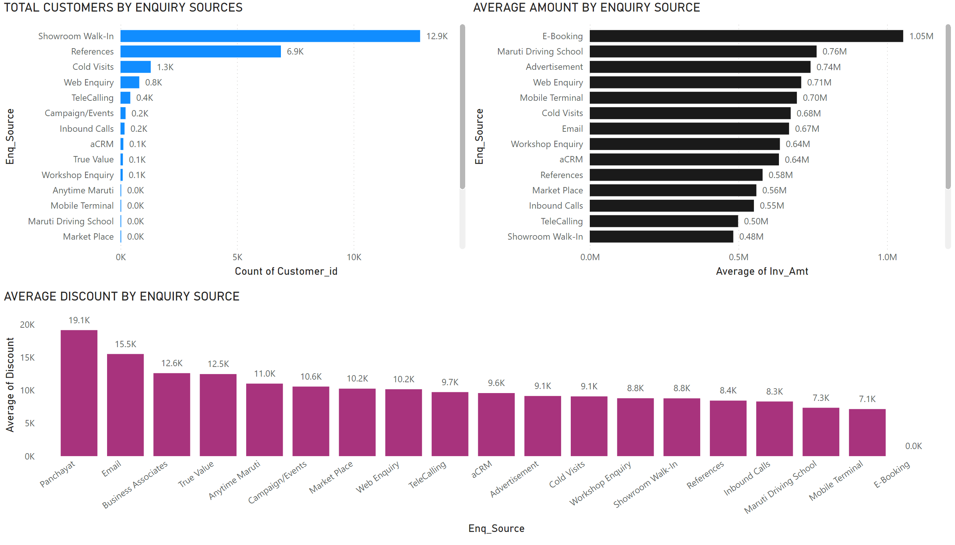
ENQUIRY
Notes:
TOTAL CUSTOMERS BY ENQUIRY SOURCES
No alt text provided
AVERAGE AMOUNT BY ENQUIRY SOURCE
No alt text provided
AVERAGE DISCOUNT BY ENQUIRY SOURCE
No alt text provided

Slide 5
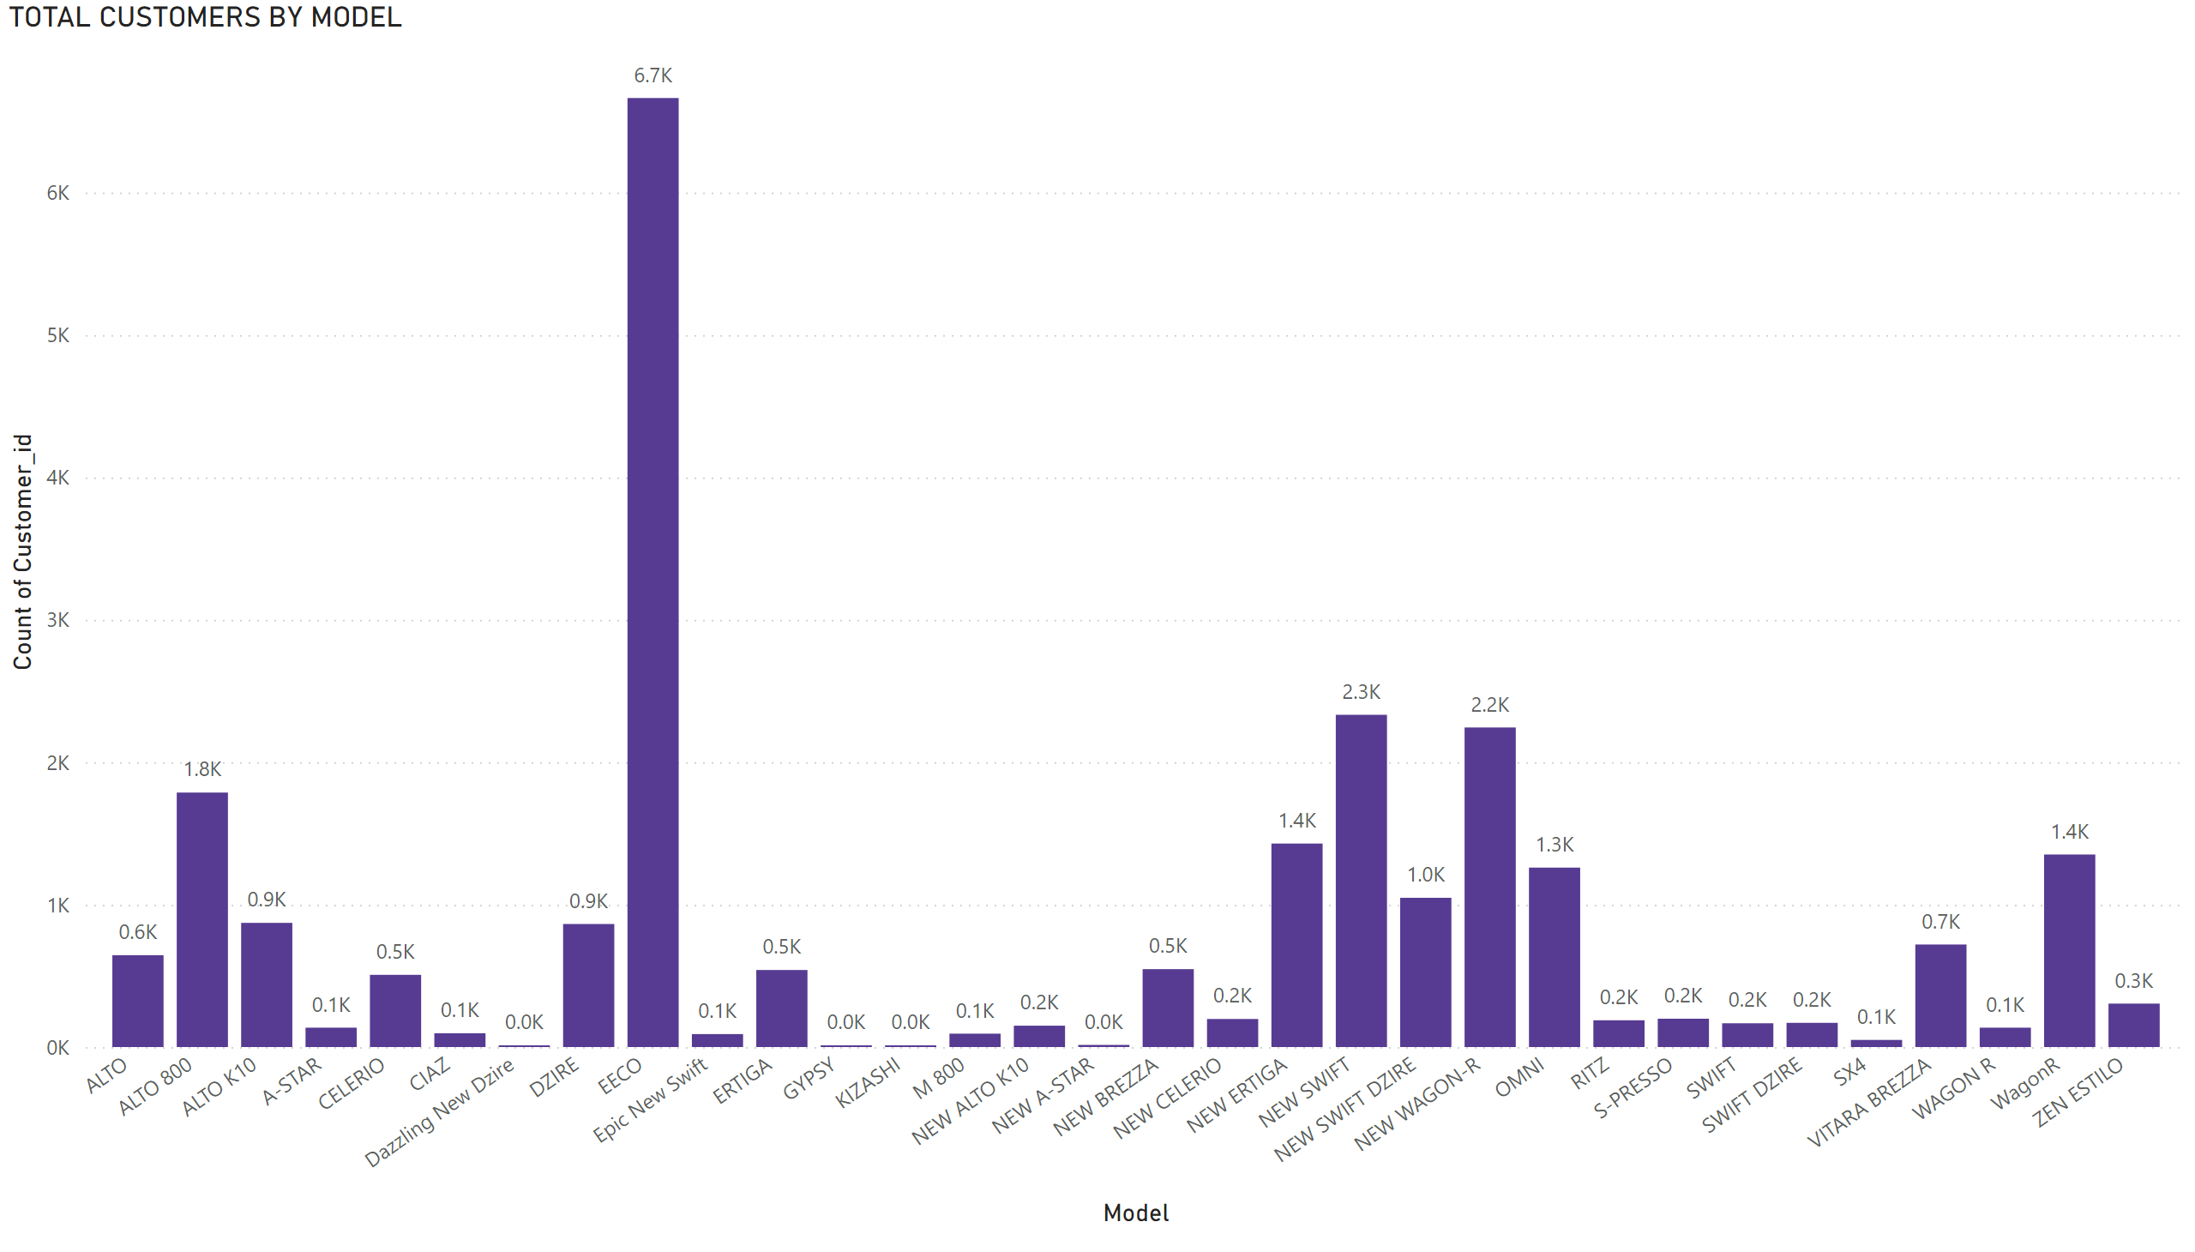
TOTAL CUSTOMERS BY MODEL1
Notes:
TOTAL CUSTOMERS BY MODEL
No alt text provided

Slide 6
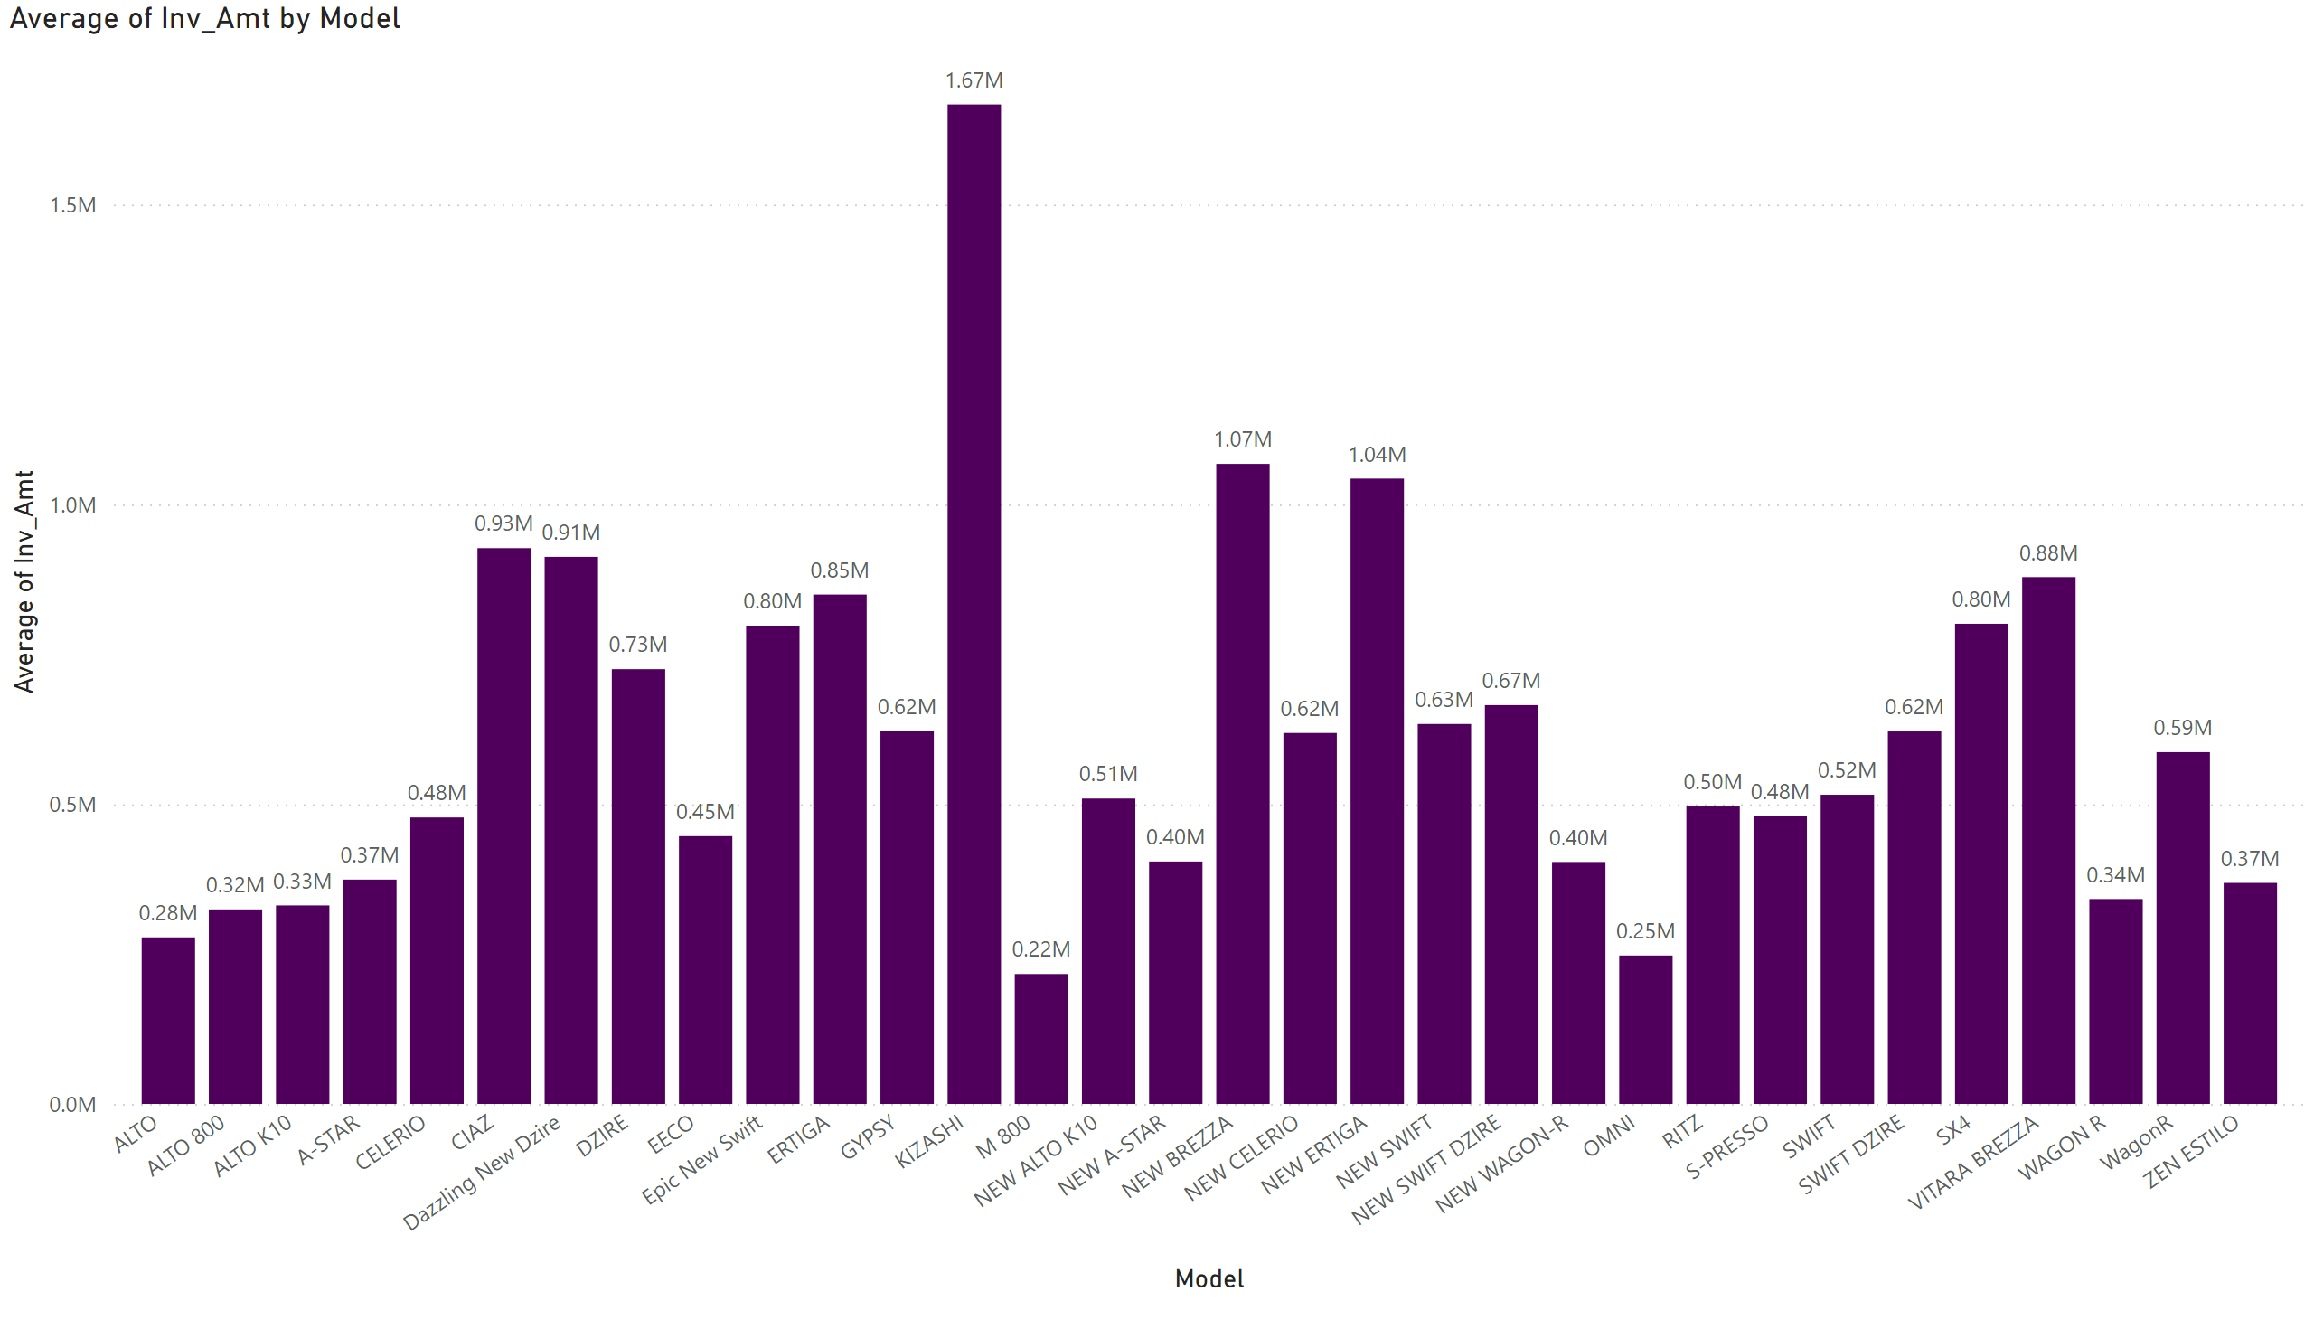
AVG AMT BY MODEL
Notes:
clusteredColumnChart
No alt text provided

Slide 7
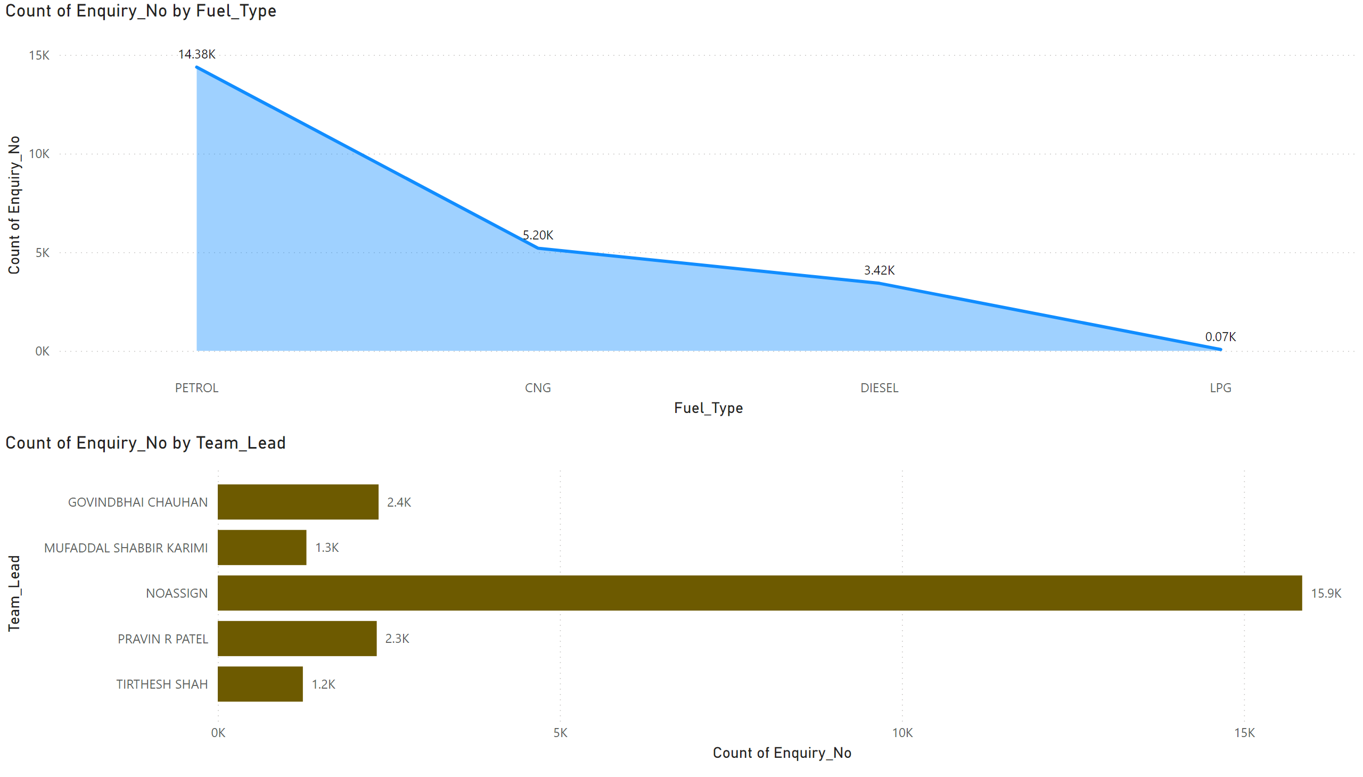
TL
Notes:
stackedAreaChart
No alt text provided
clusteredBarChart
No alt text provided

Slide 8
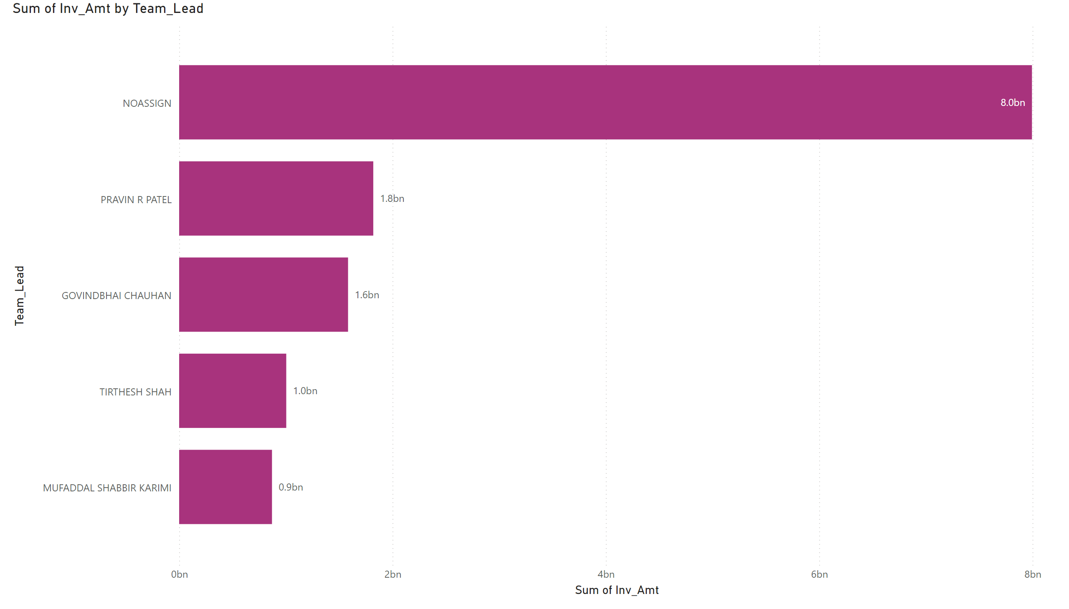
TL1
Notes:
clusteredBarChart
No alt text provided

Slide 9
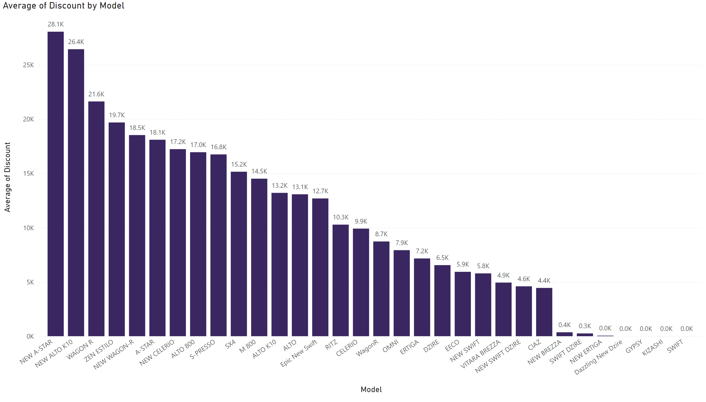
AVG DISC.
Notes:
clusteredColumnChart
No alt text provided

Slide 10
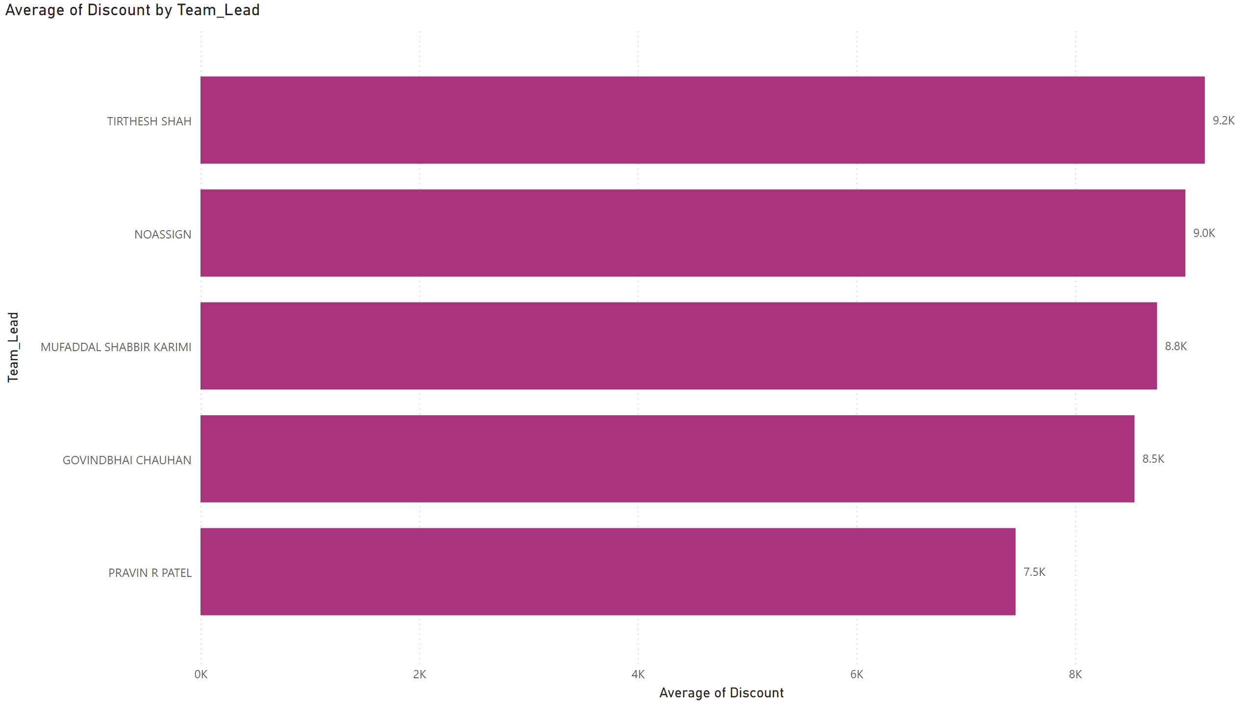
TL_DISC
Notes:
clusteredBarChart
No alt text provided

